Slide 1
Bridge modelling implementation with Lisflood-fp
Mark Trigg & Jeff Neal
September 2012

Slide 2
Bridge modelling methods
Modelling of bridges can be complex. See Hecras hydraulic reference manual, Chapter 5 for more details (http://www.hec.usace.army.mil/software/hec-ras/documents/hydref/chap05.pdf).
However, what it boils down to is accounting for the obstruction of the bridge to normal flow, raising water levels upstream. There are two main methods to do this in hecras, the energy method and the pressure flow method.
The energy method carries out a standard energy calculation as for a normal cross-section, but uses the obstruction of the bridge to recalculate the flow area and wetted perimeter, thus restricting flow.
The pressure flow method assumes the flow is controlled through the bridge opening in a way similar to an orifice. This means that the orifice equation can be used to calculate the flow through the opening.
There are other empirically based methods as well, but these tend to be specialised to particular types of bridges under certain conditions and in certain countries (eg USA) so are not really useful for us in lisflood. From experience, most models will use the first 2 approaches.

Slide 3
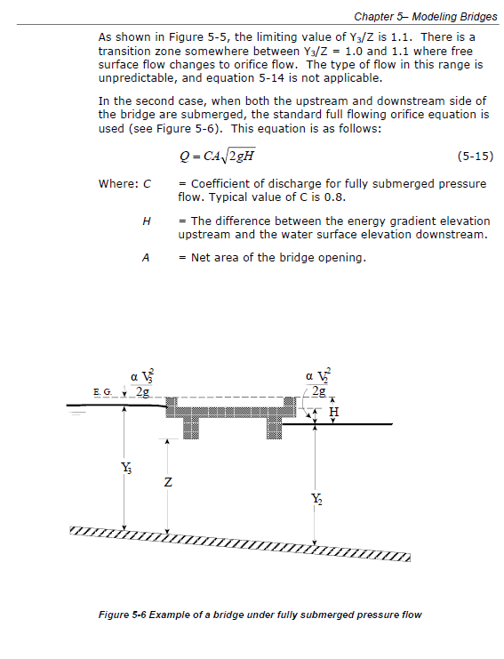
For lisflood we need a straightforward implementation for the subgrid approach, so we have decided to start with pressure flow using the orifice equation - see hecras manual chapter 5 page 21 (on right). The only difference is we use the water level difference between the cells instead of the (energy head u/s – water level d/s). Unless velocities are very high this should be a reasonable approximation. May need to check this assumption in the testing. I DID CHECK THIS AND IT IS IMPORTANT SO I HAVE MODIFIED THE CODE SO THAT IT IS NOW IDENTICAL TO HECRAS.

Slide 4
Simple Bridge test case based on
Simple Severn straight channel model with bridge at centre (50,000m) and soffit at 68 m

Slide 5
Hi Giuliano, After our discussion on Thursday, I have added a simple bridge formula to the sub-grid model in LISFLOOD (it might also work for a cell of the 2D model but I haven't tested this). So far all I have done is run the attached model to see that the bridge has an effect. Mark was planning to compare it to HEC-RAS but I'm not sure what his schedule is like. The bridge is included in the model like a weir (see user manual for weir instructions). So create a .weir file. If you were creating a weir you would add the lines: Line 1; number of weir-type linkages between cells (i). Line 2; X1 Y1 Direction1 Qcoeff1 Crest_height1 Modular_limit1 Width1 Line 3: X2 Y2 Direction2 Qcoeff2 Crest_height2 Modular_limit2 Width2 etc… … … … … … … … Line i: Xi Yi Directioni Qcoeffi Crest_heighti Modular_limiti Widthi For a bridge you would change a line in the following (e.g for line 3) Line 3: X2 Y2 Direction2 0.0 soffit_height2 Coefficient Width2 when stating the direction you must put n, s, e, w (north, south ...) followed by a b for bridge The coefficient is likely to be about 0.8 and the width will need to be the width of the sub-grid channel at the bridge for now (we can add more flexible functionality later). There is an example in the attached model. The equation implemented is: Q = coefficient*flow_area*sqrt(2*g*dH) Where dH is the change in water surface elevation across the bridge calculated from the upstream and downstream cell water surface elevations. You can have any number of bridges and weirs and the opening is assumed rectangular. Mark: There is currently a backwater effect from the boundary affecting the location of the bridge (boundary looks a bit odd also) so we might need to adjust the test case. I have added the code on sub-version but only tested in x direction. Cheers, Jeff

Slide 6
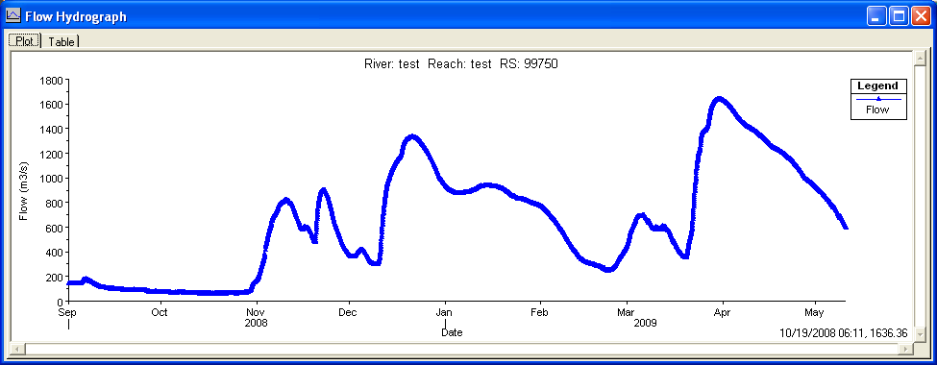
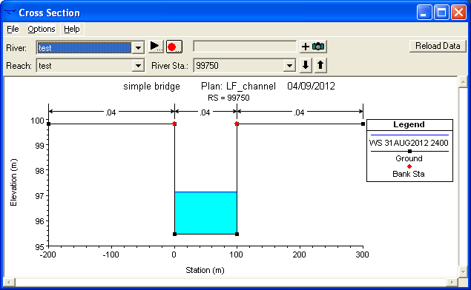
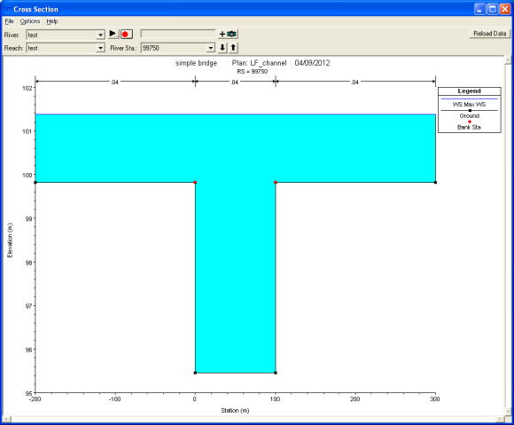
Actual simple channel Test Model Build
Details:
d = 0.12 w^0.78 = 4.356936657 m
Channel length is 100,000 m long
Cell size is 500m with 100m wide subgrid channel
Slope and boundary condition is 0.0006
SGC compared to none-SGC 5*100 m cell model with centre cells representing channel.
Unsteady flow with peak around 1650 cumecs.
Needed to adjust elevations in 500m subgrid dem to match correct location in 100m model (by ~0.03 m)
Flow comes out of bank at ~700 cumecs

Slide 7
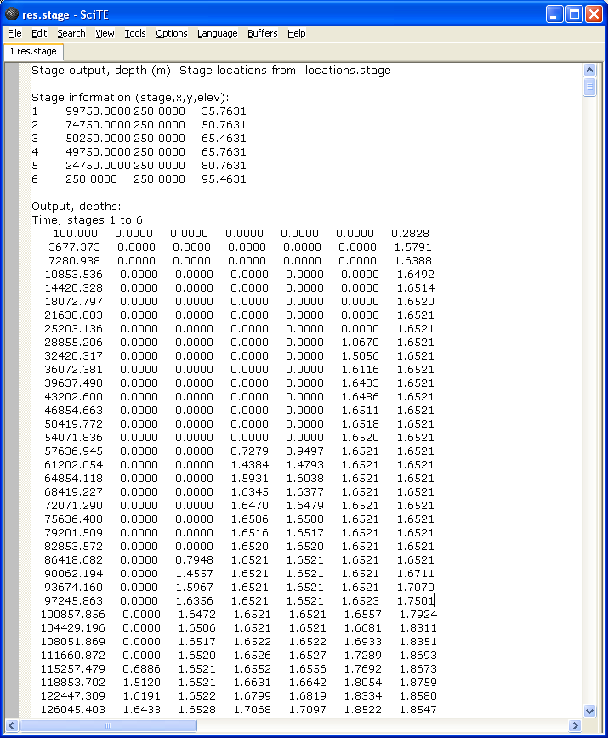
Added stage file to pickup hydrographs at 5 locations down channel.

Slide 8
Stage hydrograph at mid upper reach. Comparison between noSGC(blue) and SGC (green). Only minor differences just where flow comes out of bank, otherwise more or less identical.

Slide 9
When comparing water depths of the SGC and orifice model in areas unaffected by the bridge, we seem to have a slight discrepancy. I have checked the files and they are identical except for the orifice addition. Maybe its the BC affecting the whole model? Need to check this again when BC issue is sorted.
NOTE THIS PLOT USED DIFFERENT VERSIONS OF LISFLOOD. THE LATEST OF WHICH HAS A BC BUG. BUT THERE MAY BE OTHER DIFFERENCES SO WILL NEED TO REDO THIS WHEN BUG FIXED.
noSGC takes a few cells to fully come out of bank

Slide 10
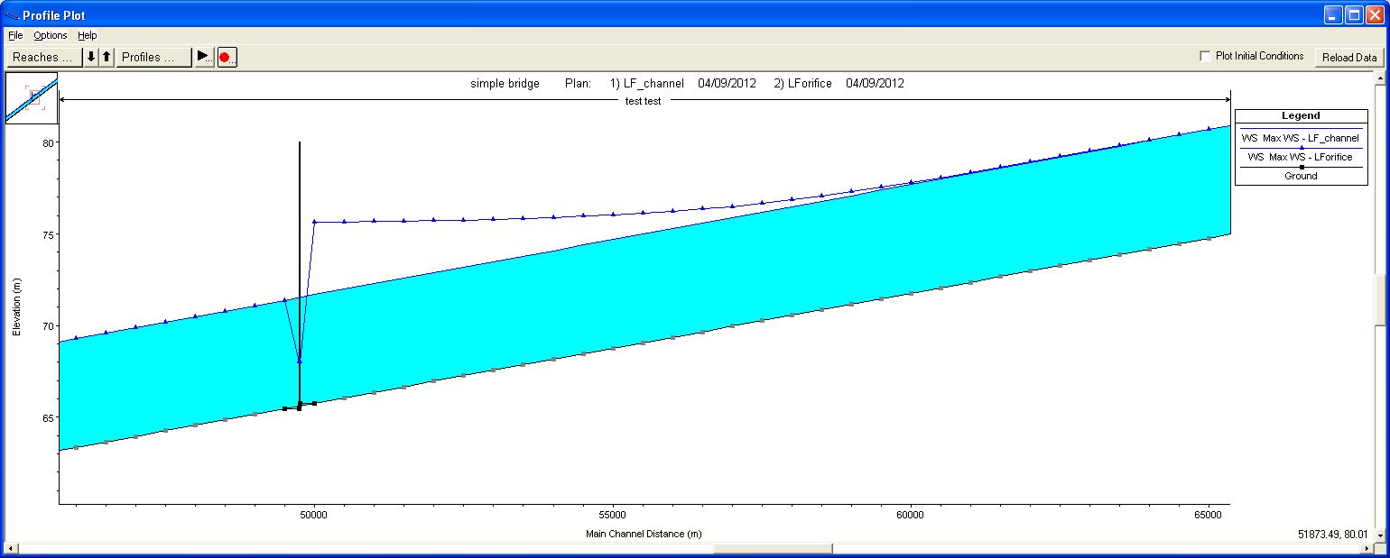
Hecras with and without bridge

Slide 11
Hi Jeff, I thought I would let you know where I had got to so far in testing. I have been comparing five models at the moment. (1) DEM channel (100m cell size) - ie no subgrid (2) SGC (500m cell, 100m SGC) (3) Hecras 100m channel within 500m floodplain as (2) (4) SGC as (2) + orifice (5) Hecras orifice as (4) Conclusions are a bit complex and I am still trying to get to the bottom of some of the differences. Some differences were due to subtle structures differences between models and h/Q calculation points as we discussed. I have taken these into account and get a better agreement now. There are a few minor differences that I can't figure out yet, but they are not big enough to worry me at the moment. So far my main conclusions are as follows. (1) SGC compares well to DEM channel and hecras. (2) SGC orifice compares well with hecras orifice except for (3) & (4). The location of the orifice seems to be out by one cell, or its being applied to the west side instead of east? (3) SGC orifice shows some instability where water level reaches the soffit level (I guess it switches calc mode as we discussed it might). This instability does not seem to propagate (I think?). (4) There seems to be a serious boundary condition problem in the SGC orifice that is not there with the normal SGC model (see plot below). My feeling is that it might be a memory overwrite thing when reading in the weir/orifice data that is corrupting the boundary condition (just a guess)? Below is a plot from the SGC orifice model. This is a plot from a new stage file I added to pick up 6 points down the channel. These are; the extreme u/s and d/s ends, 250m u/s of bridge and 250m d/s of bridge and the 25% and 75% points along the channel. The light blue is the cell u/s of the orifice(you can see the instability as levels drop back below soffit level. The dark blue is the extreme d/s cell (boundary condition). Interestingly despite the BC problem, the orifice seems to work well in predicting the increase in WL u/s of bridge/orifice. See plot below comparing with hecras just upstream of the bridge for whole model run. So I think we are on the right track. cheers, Mark

Slide 13
Comparison of max water depth along channel hecras v lisflood-orifice. Note still boundary issues in lisflood model. Otherwise still a good match.

Slide 14
Bridge test case based on KULTURisk project in Barcelonnette,France

Slide 15
Initial conceptual bridge model
Do you have any data on what level the 1957 event was? We can then make sure the test case is giving us approximately the right levels
See attached photos to give an idea
Did any of the events overtop the road deck? If so we may need to add a weir flow calc. for that bit and will need a top level.
The best course of action would be to assume that the bridge was overtopped, given that the bridge railing sides are porous.
Approx. level 1957,
Q=450 cumecs
Approx. level 2008,
Q=200 cumecs
Embankment
4.5 - 5 m
Soffit level = 4 m
Channel depth = 1.5 m
Width = 25 m
Regarding the Barcelonnette Case study, the river Ubaye is heavily embanked (approx 4.5-5m high) in the section that it passes through the town of Barcelonnette. The town has (in the past) experience two flood events in May 2008 (extrapolated peak Q=200 m3/s) and in June 1957 (Q=450 m3/s ; derived by 'expert judgement' post event analysis). The May 2008 event did not overtop the embankment but rather caused bridge pier scour and consequent failure.
Important to note is that the 1957 Flood was caused by bridge obstruction thus causing overtopping and dike breach, resulting in flooding. Thus the stakeholders 'have little faith' in hydraulic modelling that does not take into account bridges.
The following specifications are approximate. We are also still awaiting detailed bridge construction details from the Barcelonnette Municipality.
Average Channel slope = 7.88 e-3
Approximate channel width = 25m
Qpeak = 450 m3/s (causes overtopping) and Qpeak 200 m3/s (responsible for bridge scour, barely overtopping the embankments)
Approx. Channel depth = 1.5 m (average flow)
Approx. Soffit level = 4 m

Slide 16
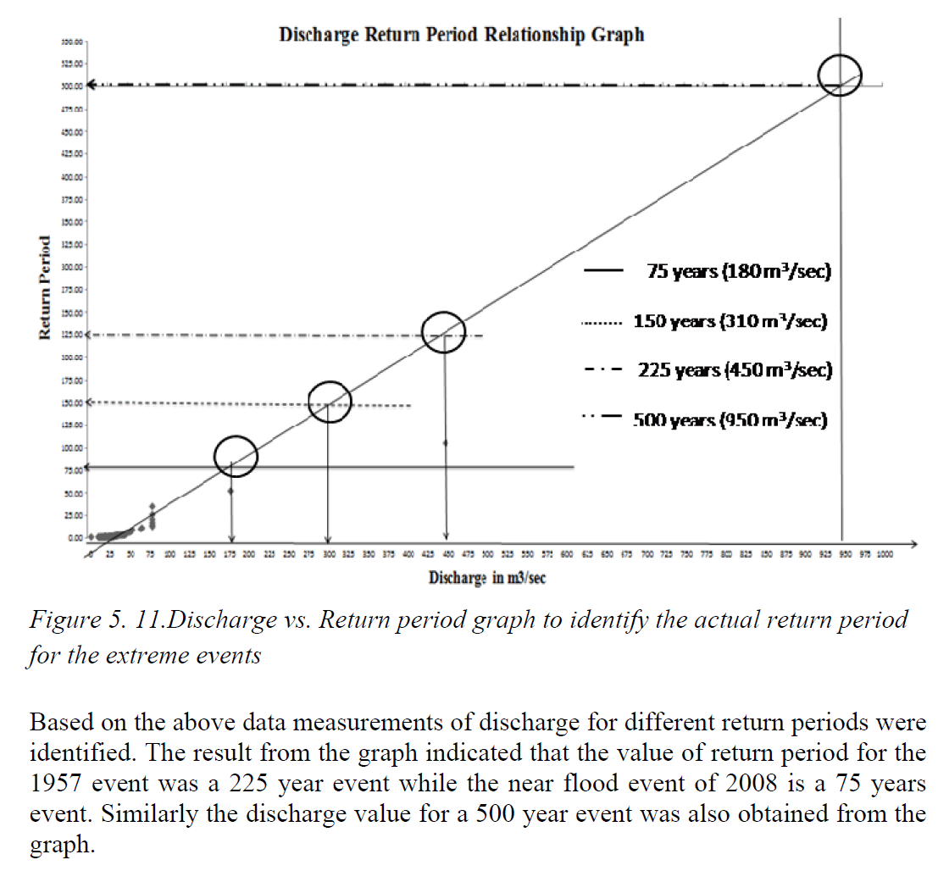


http://www.gem-msc.org/Academic%20Output/Academic%20Output%202008/GEM_Bhattacharya-22128-2010-08.pdf

Slide 17
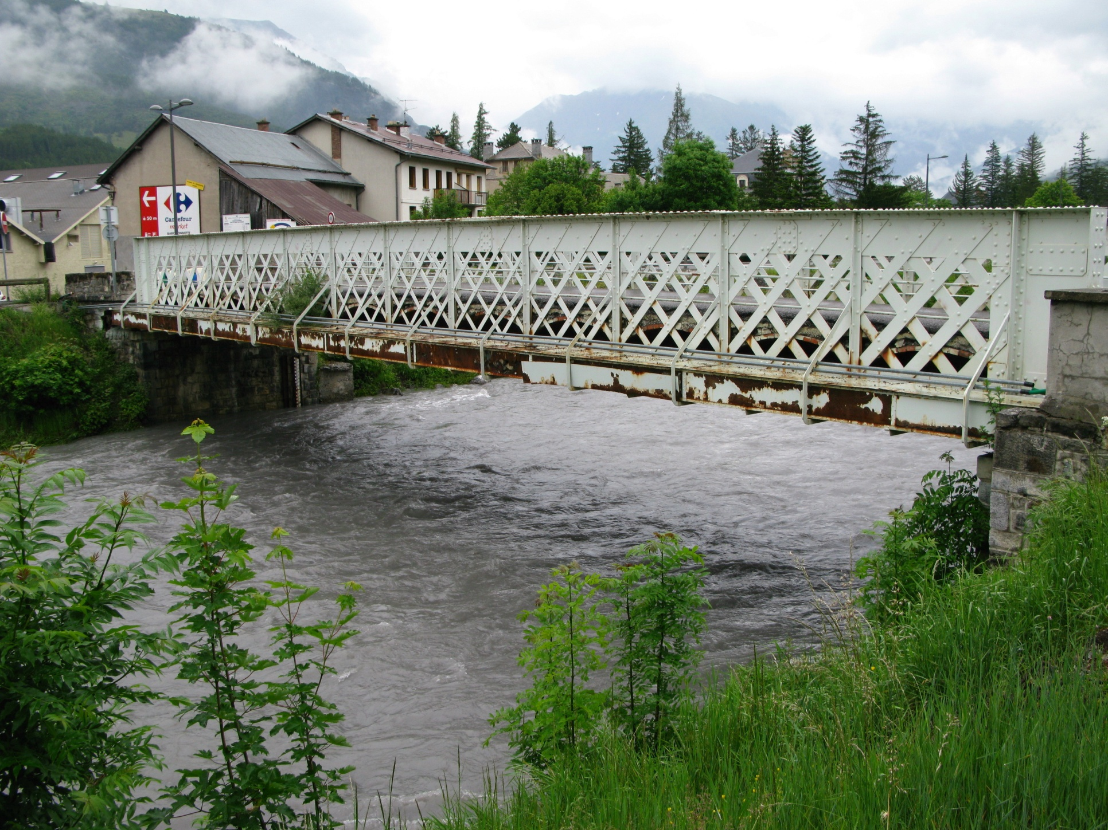
soffit = 3.75m
Width = 25 m

Slide 18
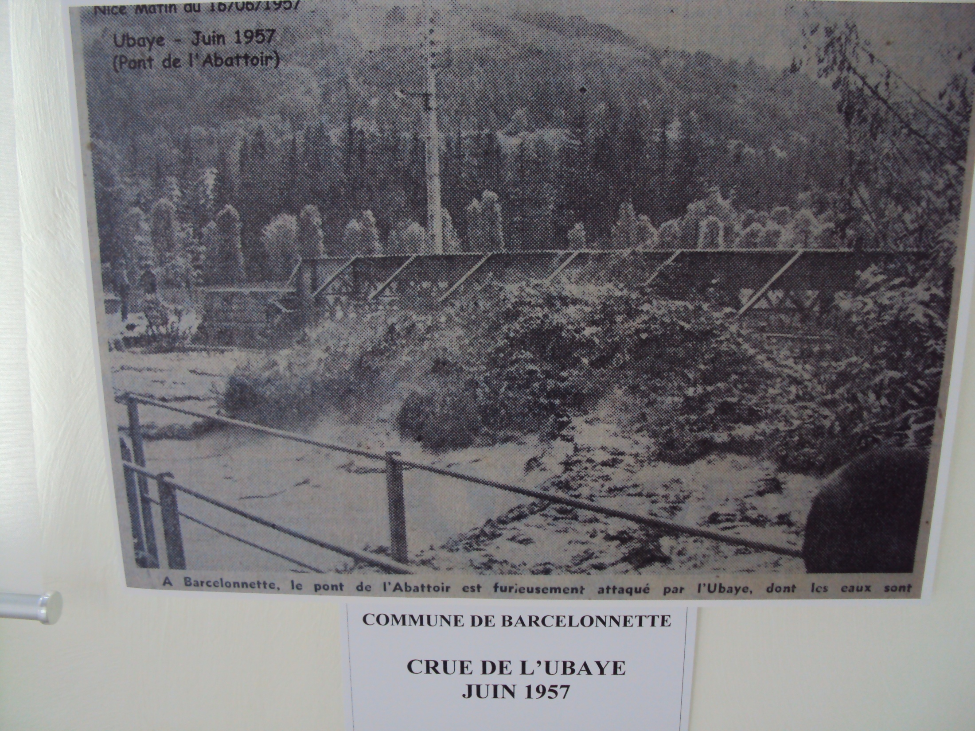

Slide 19
Actual Test Model Build
Set deck to 3 m deep to ensure all flow goes under the bridge
Approx. level 1957,
Q=450 cumecs
Embankment
Set to 6 m high to hold levels in bank
Soffit level = 3.0 m
estimate from photo
Approx. level 2008,
Q=200 cumecs
Deck depth = 1.5 m
Width = 25 m
(1) Bed slope, 0.00788 m/m, so for 10km reach, 78.8m deltaY.
(2) Assume same slope for “normal” d/s boundary condition
(3) Steady state run with profile 1= 180 cumecs (2008 event)
(4) Steady state run with profile 2= 450 cumecs (1957 event)
(5) Hecras set to model pressure an weir flow once soffit is reached
(6) Mannings set to 0.04 – rough cobbled bed?
(7) Bridge is at centre of model (5000 m)
Initial modelling with all flow going under bridge (ie no weir flow over deck as equation not implemented yet) and 1957 photo some water can go through holes in bridge sides, but mostly the deck sides are an obstruction to flow so better to model closed.

Slide 20
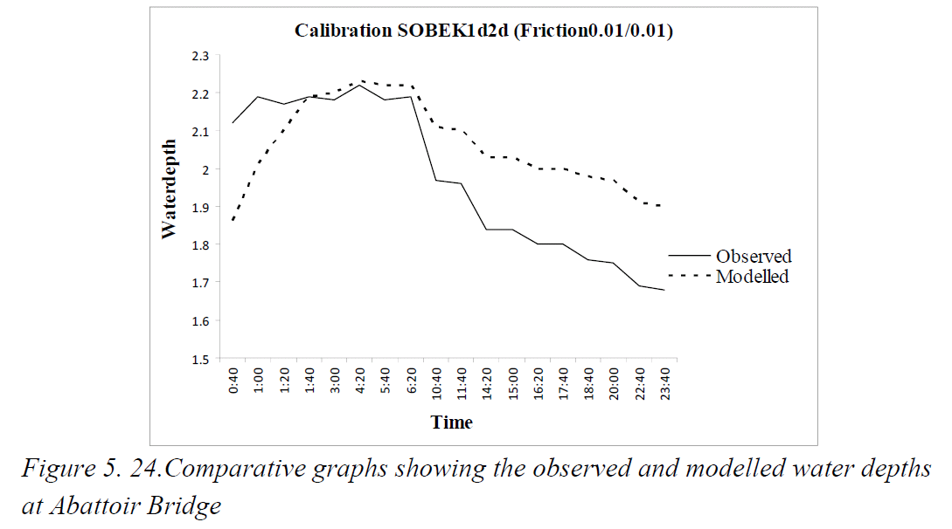
Observed water depth @ bridge for 2008 ~2.2 m for 180 cumecs

Slide 21
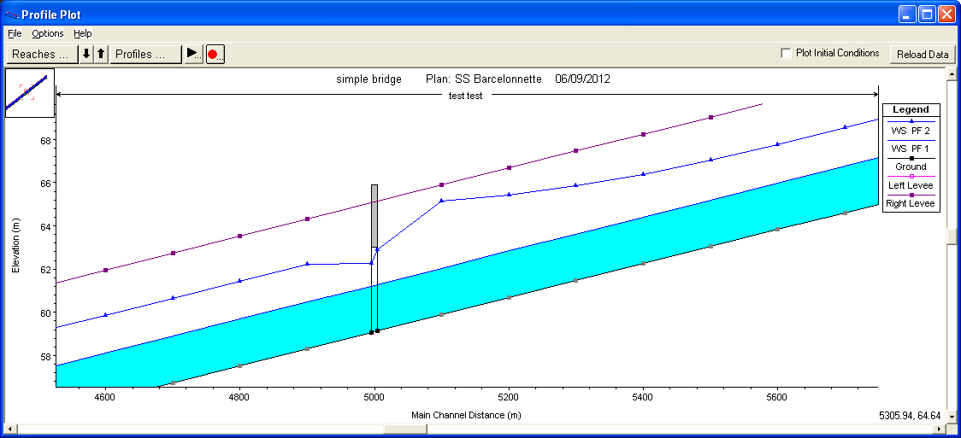
Hecras Model results
Flow depth under bridge is 2.14 m for 180cumecs (2008). Seems to match the observed levels quoted in report, but they do not come close to the bridge soffit so maybe we have the soffit level of the bridge wrong? Might be worth getting some better measurements for the real model. Channel mean velocity = 3.33 m/s Fr = 0.72.
Flow depth away from bridge is 3.92 m for 450 cumecs (1957). Flow depth just upstream of bridge is 5.27m. Note the bridge causes afflux (backwater) approximately 500-600 m upstream of the bridge. This simple model assumes no flow escapes channel, so levels may be overestimated. In addition there is some uncertainty about the soffit level of the bridge relative to the bed and this will be critical to modelling levels correctly in the full model. But for the purposes of testing the bridge code in lisflood this should be fine. Channel mean velocity = 4.6 m/s Fr = 0.74. Velocity through bridge = 4.8 m/s.

Slide 22
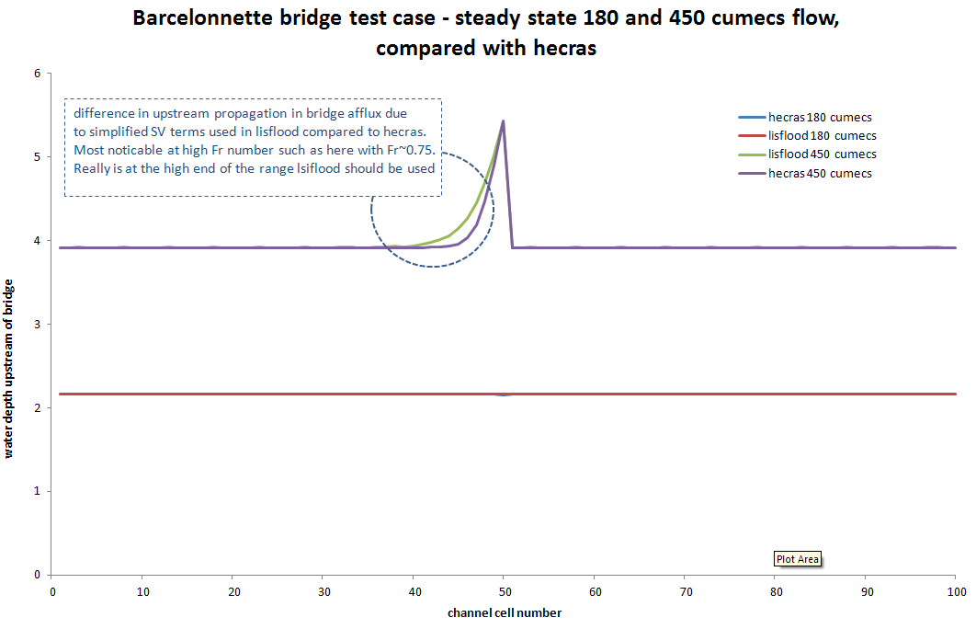

Slide 23
Lisflood Model results
Initial results show a ~0.5 m difference between lisflood and hecras levels. This is due to the initial implimentation of the orifice equation ignoring the enregy gradient component. In this case upstream V is high (~3.32 m/s) so energy gradient level (V^2/2g) is important +0.5 m.
Adding this to the lisflood code now provides a better match to hecras. There is still some discrepancy between how far upstream the effect of the bridge propagates due to lisflood inertial cal. not being the full SV like hecras.

Slide 24
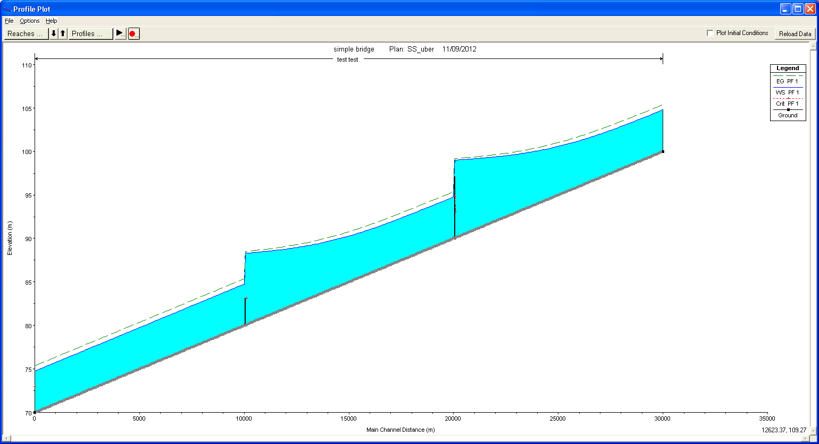
Uber 4 way test model with bridges and weirs
bridge
weir
Plan
Create channel, with bridge and weir on 30,000m long and slope 0.001. create lisfood test model with 4 of these channels that are identical except that they flow in the 4 different directions from the centre of the model N,S,W&E.
Initial problems with single centre point input and SGC boundary conditions.
Also can we have a normal 2d channel and SGC test case the same?
Building some simple 2 channel tests without the bridges and weirs to test plain channels. Problems with mass balance when inputing 4 channels flow in centre cell to split 4 ways, end up creating mass in the model although it is equal in each channel.

Slide 25
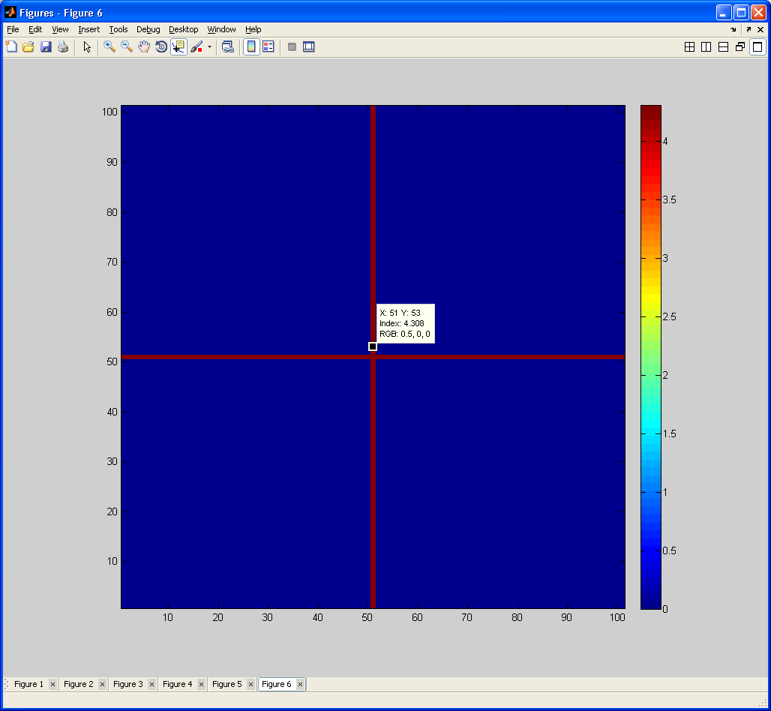

NSWE 4 way 2d dem channel test model
Plan
Create channel, 5000 m long and slope 0.001. create lisfood test model with 4 of these channels that are identical except that they flow in the 4 different directions from the centre of the model N,S,W&E.
Channel width 100m (2d dem channel not SGC) Flow input = 4000cumecs at centre of model – should flow eaqually 4 ways
Model creates a mass error so qout ~7500 cumecs. If 4 separate inputs are used instead (one cell away from the centre cell) then flows and levels are identical with no mass error.
When creating the SGC version (width 100m) there is still the BC problem, but levels indicate its using the dem level for outflow from the domain rather than the SGC bed?

Slide 26


Slide 27
diagram for manual
Plan
w
eg_{us}
WL_{us}
H
Soffit
WL_{ds}
Side
q_{us}
d_{us}
d_{b}
d_{ds}
q_{b}
q_{ds}
W = bridge opening width
d_{b} = bridge opening depth
d_{us,ds} = upstream, downstream depth of flow
eg_{us} = upstream energy grade depth (V_{us}²/2g) . bridge approach velocity V_{us} is calculated from qus divided by channel area (not bridge area)
q_{b} = bridge flow
q_{us,ds} = upstream, downstream flow
WL_{us,ds} = upstream, downstream water level
A = bridge open area (W x d_{b})
H = orifice head (WL_{us} – WL_{ds} + eg_{us})

Slide 30
Weir test. quick check of weir. consitent in 4 directions, but issue of energy head at higher Fr and also in and out of bank local instabilities

Slide 31
uber 4 SS way test results
difference due to fact that lisflood does not use the upstream energy head – only the water head. at higher Fr this is a problem

Slide 32
simple weir hydrodyanmics test results

